Slide 1
Peer Review Workshop
Presented by Team SE18-08S

Slide 2
Content
Reviewer Roles
Brief Overview of System
Key Use Cases Inspected
Inspection Summary Findings
Process Improvement
Q & A

Slide 3
Roles Assignment for Reviewing
No | Participant | Role
1. | Phung Kim Cuong, Dio | Presenter, Reviewer
2. | Zaw Htet | Reviewer
3. | Thida Khin Myo Thaung | Recorder, Reviewer
4. | Hnin Nu Aye | Reviewer
5. | Feng Yan | Producer Rep, Reviewer
6. | Jiang Jifa | Reviewer
7. | Liu Peishan | Moderator, Reviewer

Slide 4
Brief Overview of System
Project LTM Remote Manager - iPhone app for F5 Singapore
Allow users to connect to a Big-IP LTM device to receive notifications and perform administrative tasks.

Slide 5
Key Use Cases Inspected
Edit Device Parameter
Remove Device Parameter
Add Plot Chart
Remove Plot Chart
View Notification History
View List of Virtual Servers

Slide 6
Inspection Findings
Severity | Before Inspection Review | After Inspection Review
Major (1) | 0 | 0
Major (2) | 5 | 0
Major (3) | 16 | 6
Minor (4) | 12 | 11
Minor (5) | 7 | 9
Others (6) | 0 | 14
Total | 40 | 40

Slide 7
Inspection Findings

Slide 8
Inspection Findings
Measures & Metrics | Value | Measures & Metrics | Value
Inspection Time | 10.25 | Total # of Major Defects | 6
Total Pages Inspected | 41 | # of Reviewers | 7
Kickoff Time | 15 min | Logging Time | 1 hour
Average Checking Time | 1.46 | Average Checking Rate | 7
Major Defects Per Hour | 0.67 | Major Defects Per Page | 0.15
Remaining Defects Per Page | 0.06

Slide 9
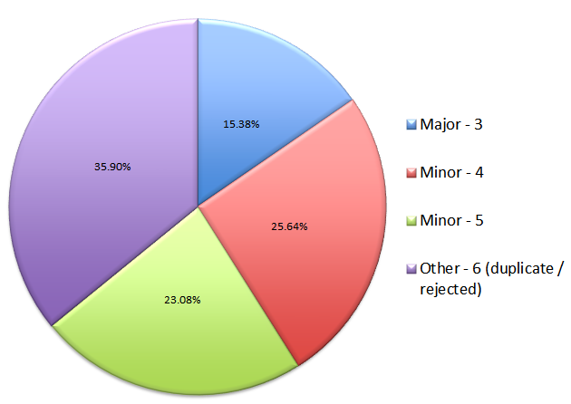
Inspection findings
Defect classification chart

Slide 10
Process Improvement – Lesson Learnt
Learnt that most of the mistakes are made are common and minor mistakes, such as inconsistency and ambiguous statements
Learnt to document the defects found properly by using the IIIF
Understanding the roles & responsibilities are important in order to perform the work effectively

Slide 11
Process Improvement – Work Product
Assign an expert as the standard guidance for each work product deliverable
Perform Buddy Check for the work product
QA to check on layout, formatting, spelling & grammar

Slide 12
Process Improvement – Inspection Process
Defect description should be clear and modular
To shorten discussion of a defect
Need to have inspection checklist available

Slide 13
Q & A

